Slide 1
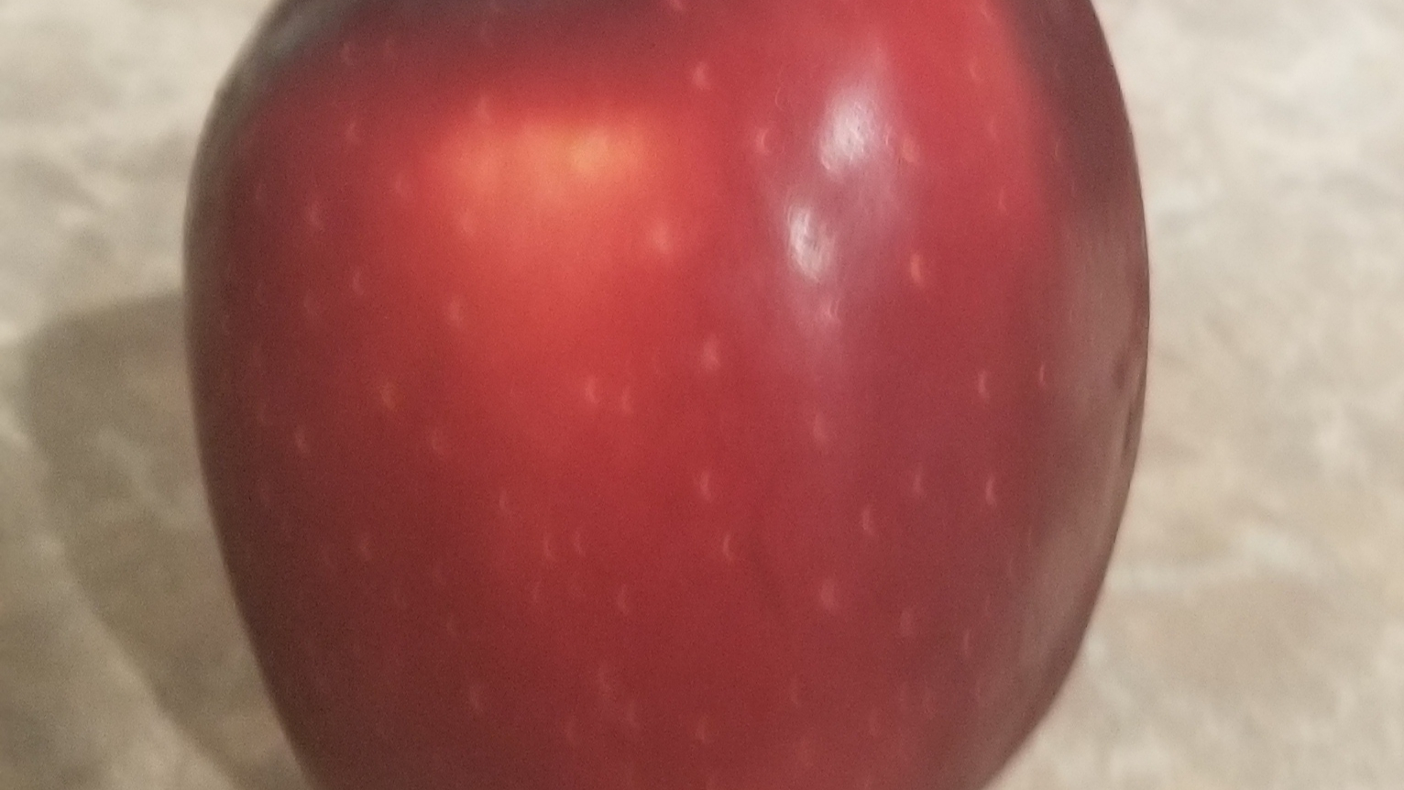
Nutrition Basics
Gilbert Nelson
HW499-01: Bachelor’s Capstone in Health and Wellness
Purdue University Global
Notes:
Educating the community on the fundamentals of sound nutrition.

Slide 2
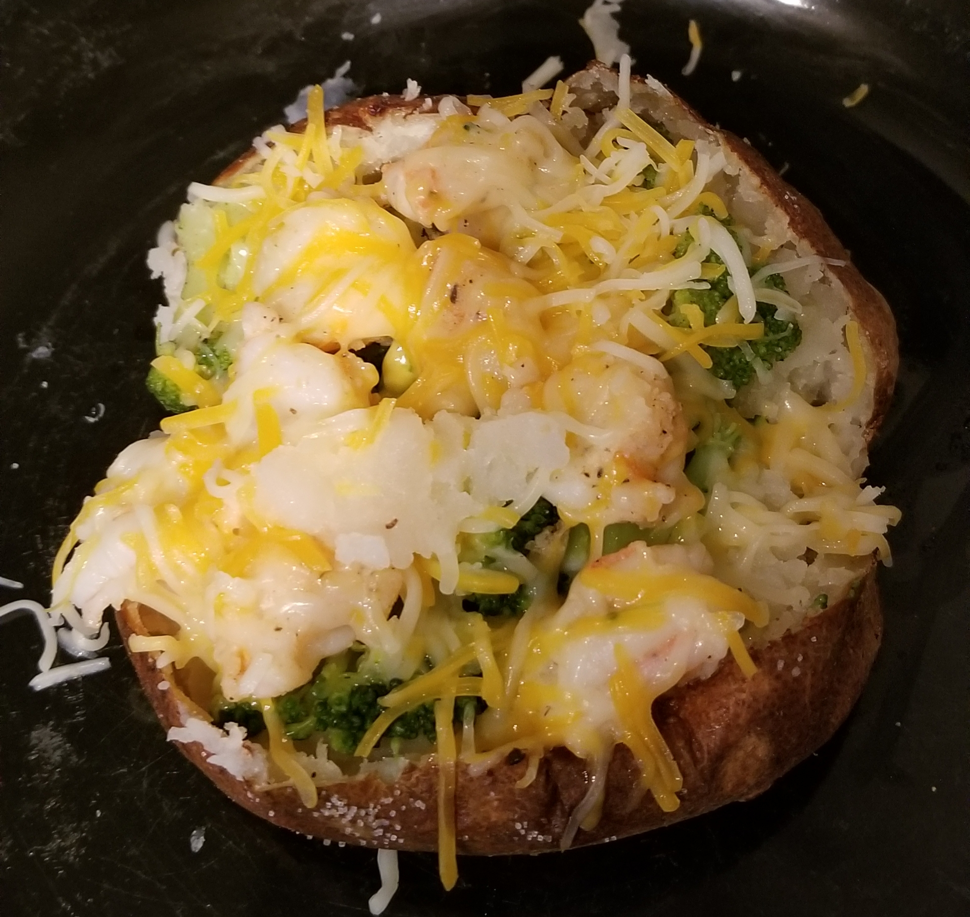
Contents
Defining Nutrition
Macronutrients
Micronutrients
Water
Improving Nutrition
Stress and Nutrition
Health and Nutrition
References

Slide 3
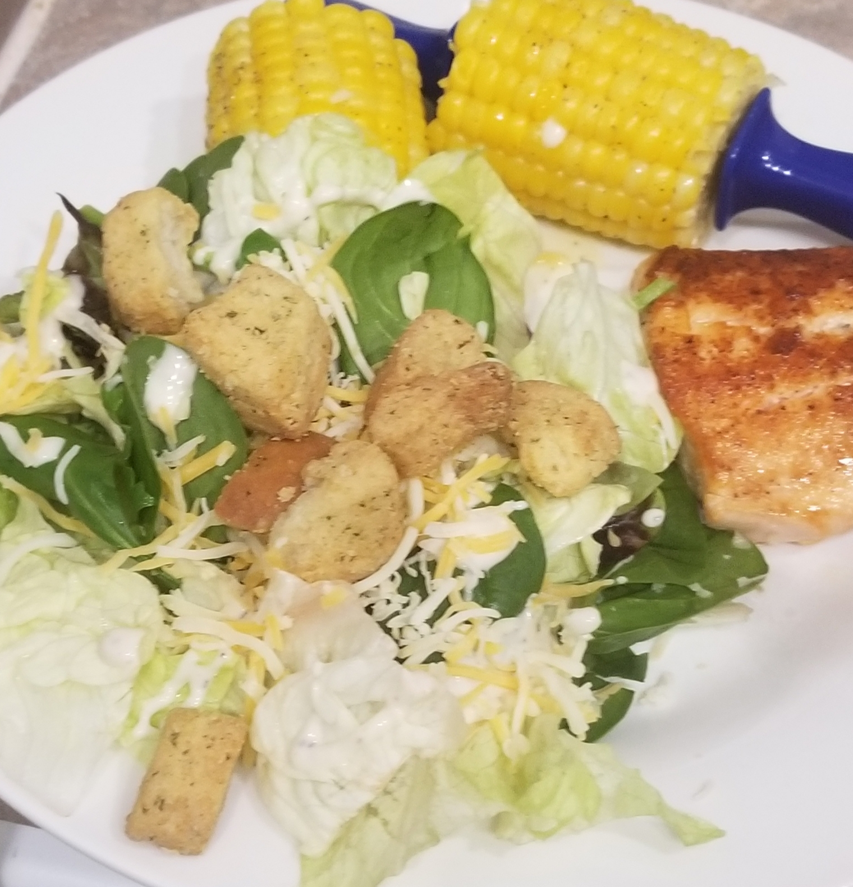
Defining Nutrition
Fuel
Standards
Good nutrition
Current Trends
Notes:
Nutrition is the sum of all processes involved in taking in food, releasing the nutrients in contains, and assimilating and using these nutrients to provide energy and maintain body tissue.
Nutrition; to nourish and is the sum of food that is eaten and its influence on physical, social, personal life. Growth and maturation and health; good nutrition minimizes risk of obesity as well as conditions such as cardiovascular disease.
Food is fuel that is supplied to our body and is transformed into the energy required to sustain the reactions needed to maintain the body’s homeostasis (temperature), and metabolism.
Understanding the individual nutritional needs for the personal lifestyle makes it easier to set a nutritional standard. Following a well-balanced and sustainable eating pattern is one of the keys to success of proper nutrition. Information on nutritional guidelines can be found at https://www.choosemyplate.gov/dietary-guidelines; overview of easy to follow information for consumers and nutrition professionals.
Good nutrition is fueling the body with the nutrient it needs through the consumption of foods that are nutrient dense and provide the correct of caloric energy that supports and sustains a healthy metabolism.
About 75% of the population are eating below the recommended amounts of fruit, veggies, oils and dairy. 50% meeting and exceeding grain and protein foods; most of Americans are exceeding sugar, saturated fat, and sodium recommendations.

Slide 4
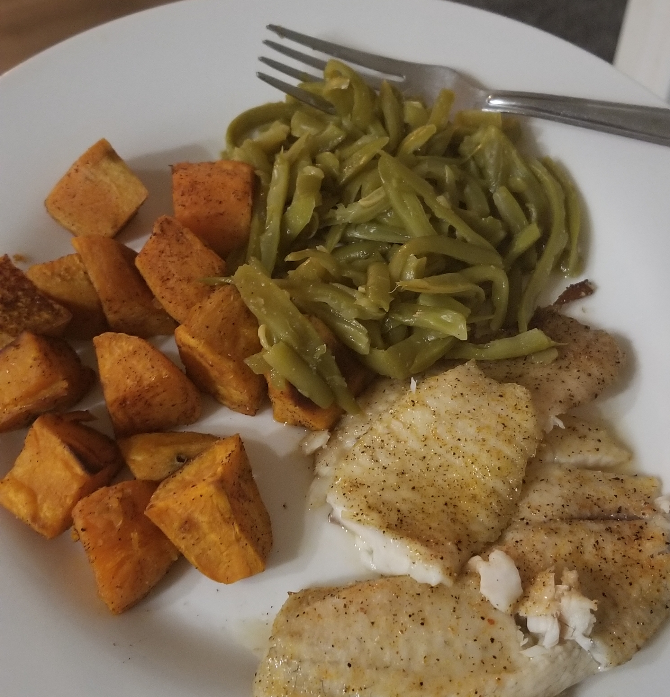
Macronutrients
Protein
Carbohydrates
Fats
Notes:
Provide energy, build and repair tissues and structures, regulate metabolic processes the maintain homeostasis (internal control system).
Carbs and fat are preferred energy sources.
Carbs are starches and sugar; heat and energy. Glucose major energy source of the body; breakdown of carbs; glycogen is stored form of carbs utilized when quick need for energy. Fuel factor is 4 calories per gram. Well-balanced eating pattern carbohydrate consumption is at 45-65% of energy intake and should be dominated by complex carbs, fiber, and minimal extra sugar.
Fats; animal or plant sources provide alternate form of stored energy; fuel factor of 9 calories per gram. Choose healthy forms of fat; mono and polyunsaturated fats with minimal processed saturated fats. 20-35% of total calories.
Protein is the tissue building nutrient but is called on for energy when needed as in the case of carbs and fat fuel is insufficient. Fuel factor of 4 calories per gram and should provide 10-35% of total calories. Broken down into amino acids; building blocks for growth and repair. Breakdown and build up affects growth and sustains body structure. Enzymes and hormones are formed from proteins; regulate body systems.

Slide 5
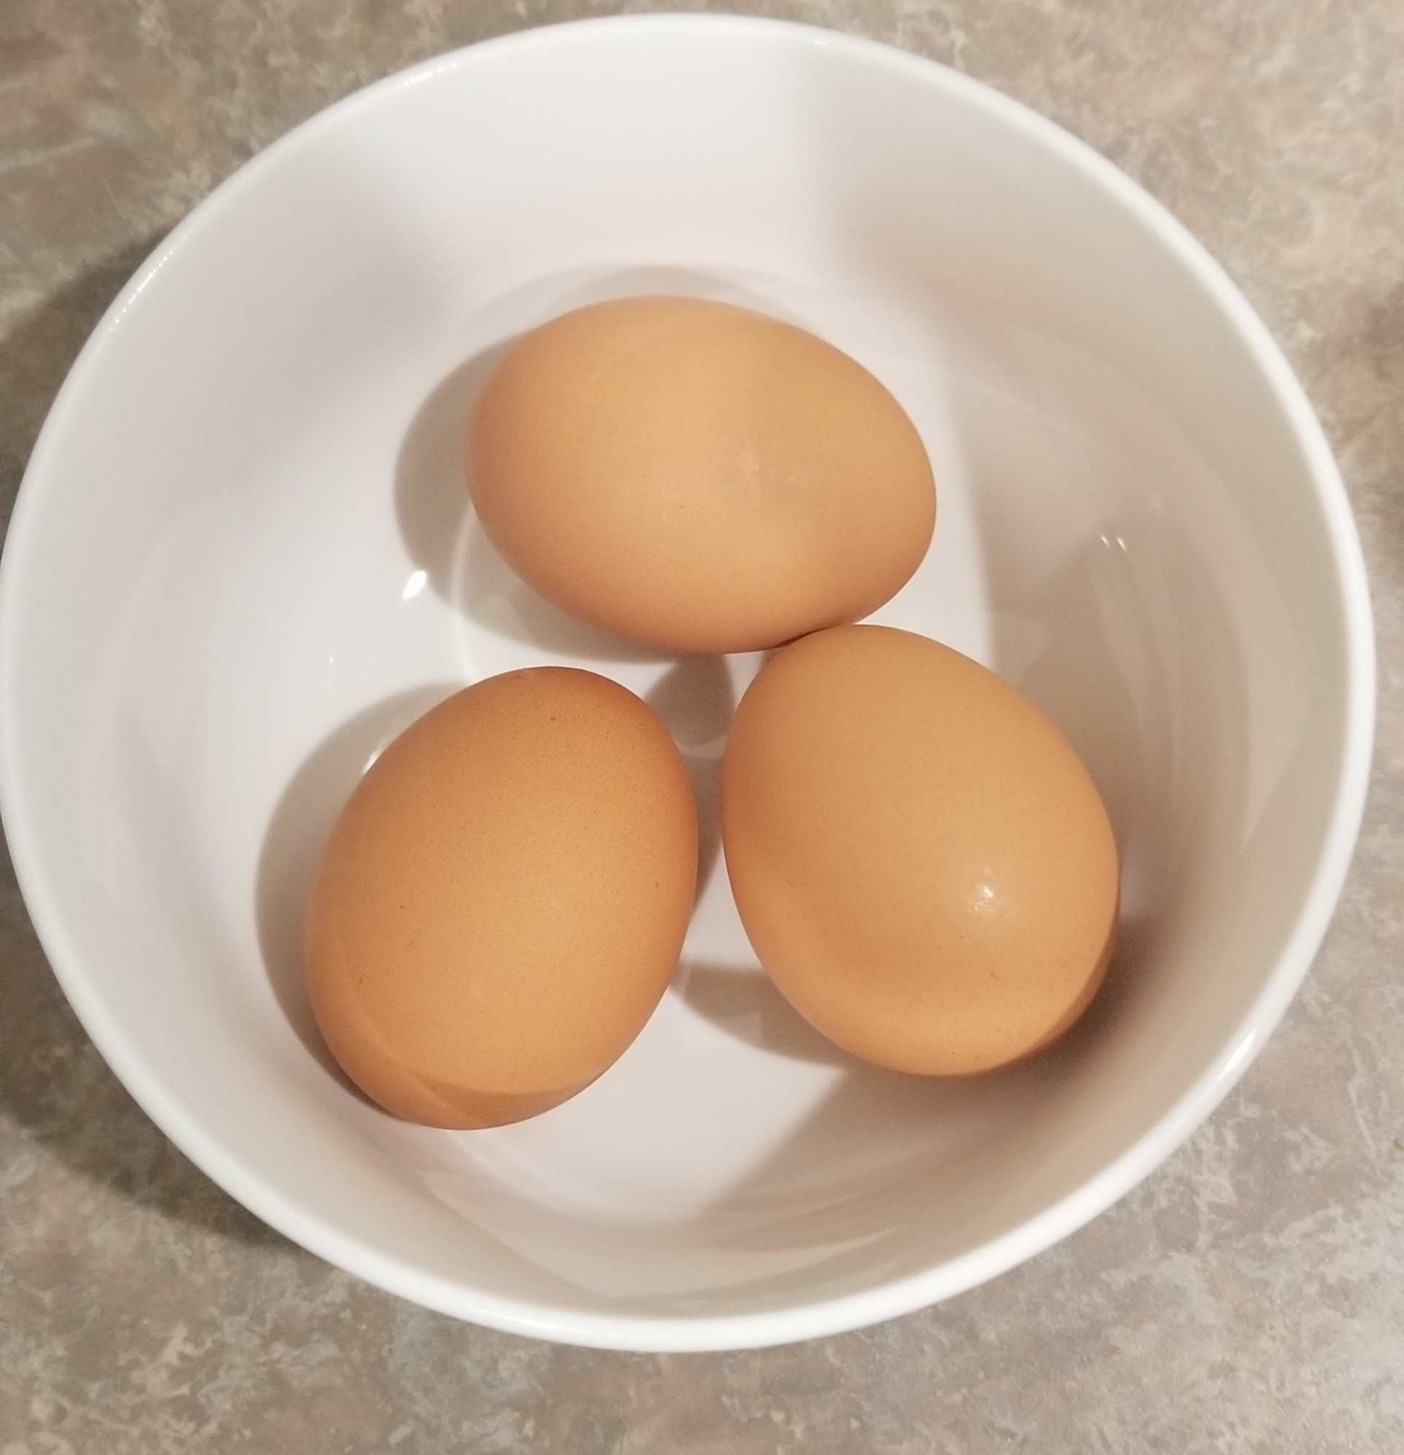
Micronutrients
Vitamins
Minerals
Notes:
Vitamins; fuel reactions that produce energy and synthesize important molecules. Example, thiamin (B1) controls release of energy for cell work, B12-synthesis and maturation of red blood cells.
Essential but needed in small amounts; help build tissue, specific functions minerals (calcium, phosphorus) strengthen bones and teeth.
Minerals cofactor in control of cell metabolism (iron controls enzyme action in mitochondria).

Slide 6

Water
Functions
Intake
Factors for Increase
Notes:
Essential to the life of all cells. Medium for chemical reactions in metabolism to take place.
Functions-body form and structure, dissolves substances in tissues and cells, transports nutrients and waste, controls body temperature, dissolves medications.
Adequate intake (AI) for water adult males 13 cups and 9 cups for adult females.
Factors for increase intake of water: high protein intake, high fiber intake, intense physical activity, medications.

Slide 7
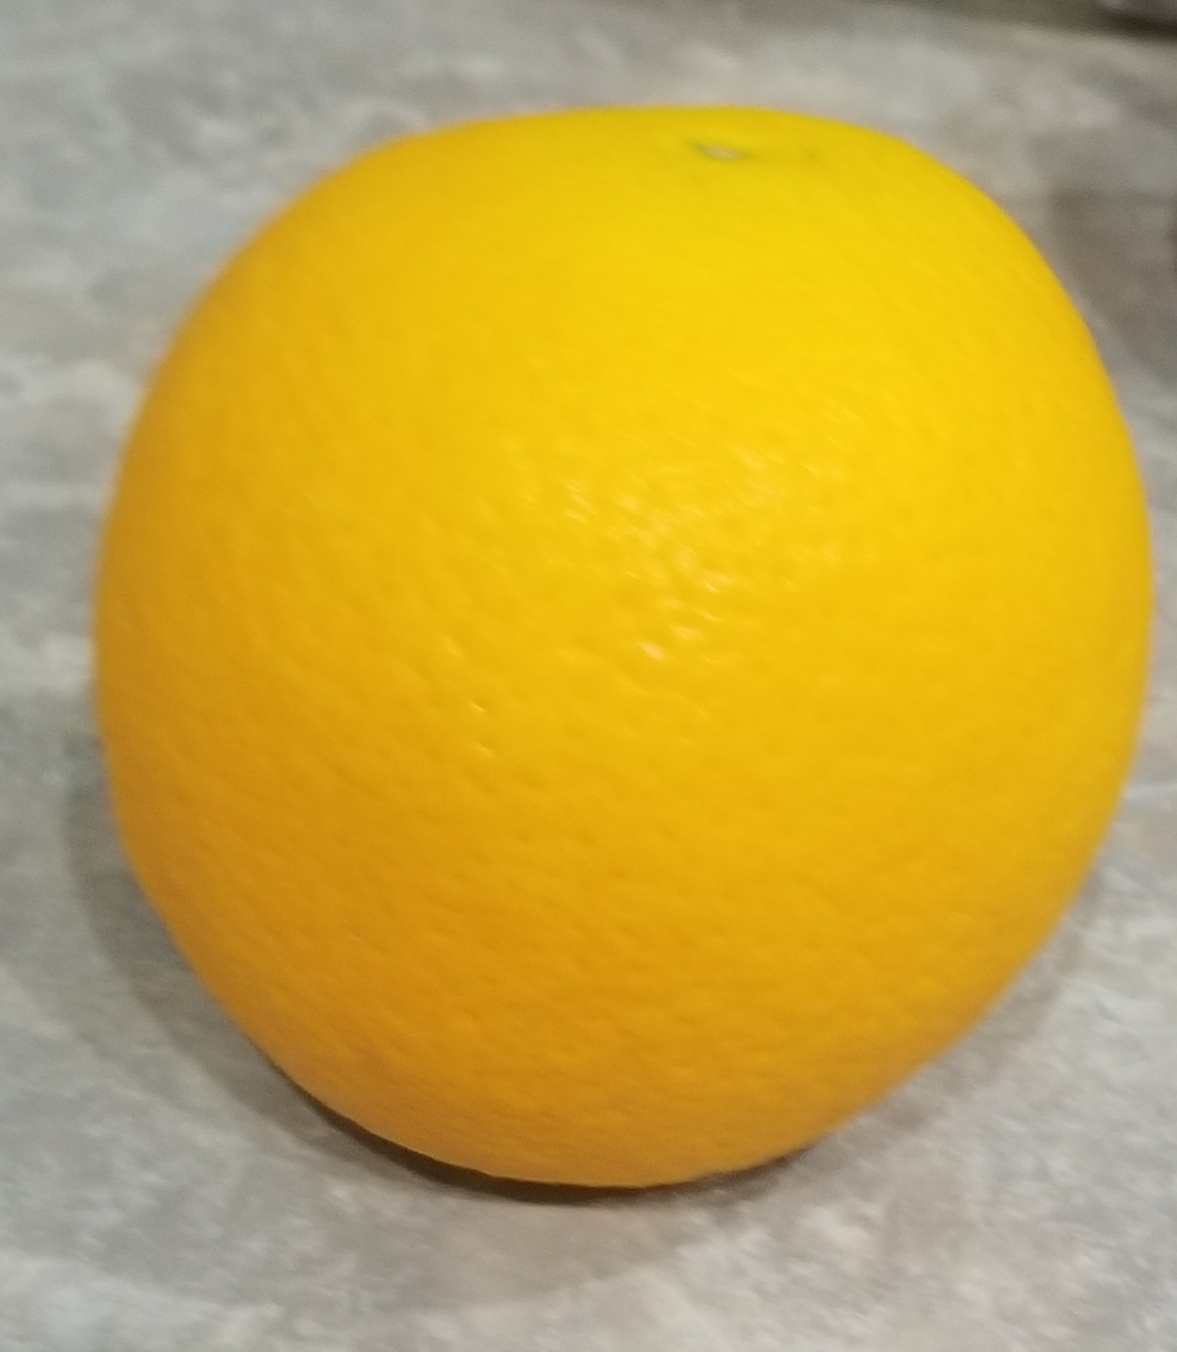
Improving Nutrition
Meal Prep
Balance
Accountability
Consistency
Notes:
Nutrients do not work alone. One can serve a specific task as a primary contributor, but then serves a secondary role in other reactions. Balance is essential to eating well.
Choosing a variety of starches (potato (white, sweet), rice (white, brown), peas, beans, quinoa), fibrous carbs (broccoli, spinach, kale, asparagus, green beans, cucumber, cabbage), protein (fish, beef (grass-fed), chicken, turkey, pork), fats (extra virgin olive oil, canola oil, flax seeds, almonds, pecans, walnuts, avocado). Dairy low-fat products (milk, yogurt, cheese).
,
Meal prep tips-list meals, easy recipes, flexible foods (used in multiple dishes), choose a day to prep 3 days to a week out, have favorite foods on hand, portion control.
Utilize self-monitoring system; online tracking, food diary, food log, meal plan, connect with nutrition professional.
www.my-calorie-counter-.com, www.myfitnesspal.com
Set nutrition improvement goals for the meal, day, or week, i.e. more greens at lunch, fruit and pecans for mini-meal, 8 cups of water.
Stay motivated to bring about consistent improvement. Don’t have to work alone, have family and friends who may need to improve nutrition to join in on the journey.

Slide 8
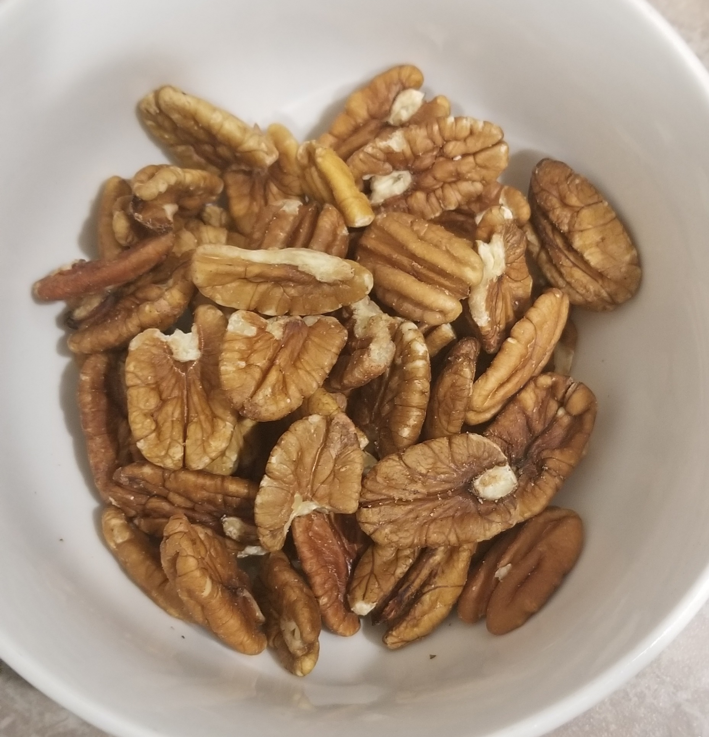
Stress and Nutrition
Cravings
Deplete Vitamin Stores
High Blood Pressure
Immune System Depletion
Notes:
Cortisol increases when stressed; increases the production of neuropeptide Y (NPY) in the brain which is responsible for carb cravings (sweets).
Excess sugar intake can deplete B vitamin stores (niacin, thiamin, riboflavin, b6, b12).
Increase in salt intake increases water retention and blood volume causing a rise in blood pressure (hypertension).
Excessive alcohol may suppress immune system due to water-soluble vitamins and minerals (potassium, magnesium, calcium, and zinc)

Slide 9
Community Resources
Nutrition Professionals
Free Consult
Assessments
Grocery Store Tours
Notes:
Motivate audience to utilize information for positive change in eating habits, or to continue to show improvements.
Access the readiness of those of the community to make a change utilizing the Transtheoretical Model for Behavior Change, and set up more follow-up sessions and encourage audience participation (cooking seminar, q & a, registered dietician and nutritionist resources).
Goal for the community outreach is to provide information that is not only new, but easy to understand, influencial, and can be easily applied and to do this we need to stay abreast on community needs as it pertains to access to quality foods, as well as resources to aid in food selection.
Handouts, surveys, interviews.

Slide 10
References
Advanced Meal Prep Tips and Tricks. (2019). Retrieved from: https://www.medicinenet.com/food_recipes_meal_pr ep_tips- tricks/article.htm?ecd_mnl_spc_06081
Schlenker, E. & Gilbert, J. (2015). Williams’ essentials of nutrition & diet therapy, 11th edition. St. Louis, MO: Elsevier Mosby, Inc.
Seaward, B.L. (2015). Managing stress: Principles and strategies for health and well-being, 8th edition. Burlington, MA: Jones & Bartlett Learning, LLC.
Shifts Needed to Align with Healthy Eating Patterns: Current Eating Patterns in the United States. (2015). Retrieved from:https://health.gov/dietaryguidelines/2015/guide lines/ chapter- 2/current-eating-patterns-in- the-united- states/

